Slide 1

Cyclistic bike-share case study
ENG.AHMED FAHMI

Slide 2
Ask phase
This question will guide the future marketing program:
How do annual members and casual riders use Cyclistic bikes differently ?

Slide 3
Business Task
Analyze data to gain insights into how users use Cyclistic's bikes by membership type and to identify trends based on Cyclistic's marketing strategy.

Slide 4
PREPARE phase
Guiding Questions
Q1: Where is your data located ?
The data is available at the address I gave the https://divvy-tripdata.s3.amazonaws.com/index.htmlabove. The data I have downloaded from this address have been handled in a way to cover 12 months .

Slide 5
Are there issues with bias or credibility in this data? Does your data ROCCC?
Yes, the data appears to be ROCCC. There don't seem to be any issues with bias or credibility in the data, as it consists of trip data from Cyclistic's own bike riders and is made available under license by Motivate International Inc. Additionally, the data appears to be reliable, original, comprehensive, current, and cited, meeting the criteria for ROCCC.
How did you verify the data’s integrity?
To verify the integrity of the data, it is important to check the data for any inconsistencies or errors. This may include checking for missing or incorrect data, identifying outliers or unusual values, or comparing data with other sources to ensure it is correct. I carried out this analysis with simple and fast methods in R language and as a result I checked that the data is consistent. I identified missing and incorrect data types, removed them and made them ready for analysis.

Slide 6
PROCESS phase
What tools are you choosing and why?
I used the R programming language,ms sql server and tableau to process the data and make it ready for analysis

Slide 7
Analyze phase
How should you organize your data to perform analysis on it?
First of all, the driving data had to be grouped according to user types, hours, time zones of the day, days of the week, months and seasons, and I organized the data to be that way. As can be seen in the R markdown document that I just shared during the process phase, time columns were created and the driving data of the users were classified according to the time type. In addition to examining the average and total driving times of the user types, the driving time lengths were also extracted from the data in the data frame, such as the end and start time, and included in the analysis, and important insights were obtained.

Slide 8
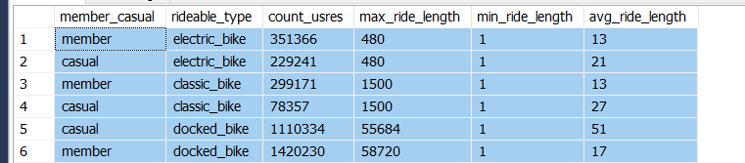
Share phase
Now that I have performed my analysis and gained some insights into my data, create visualizations to share my findings.

Slide 9
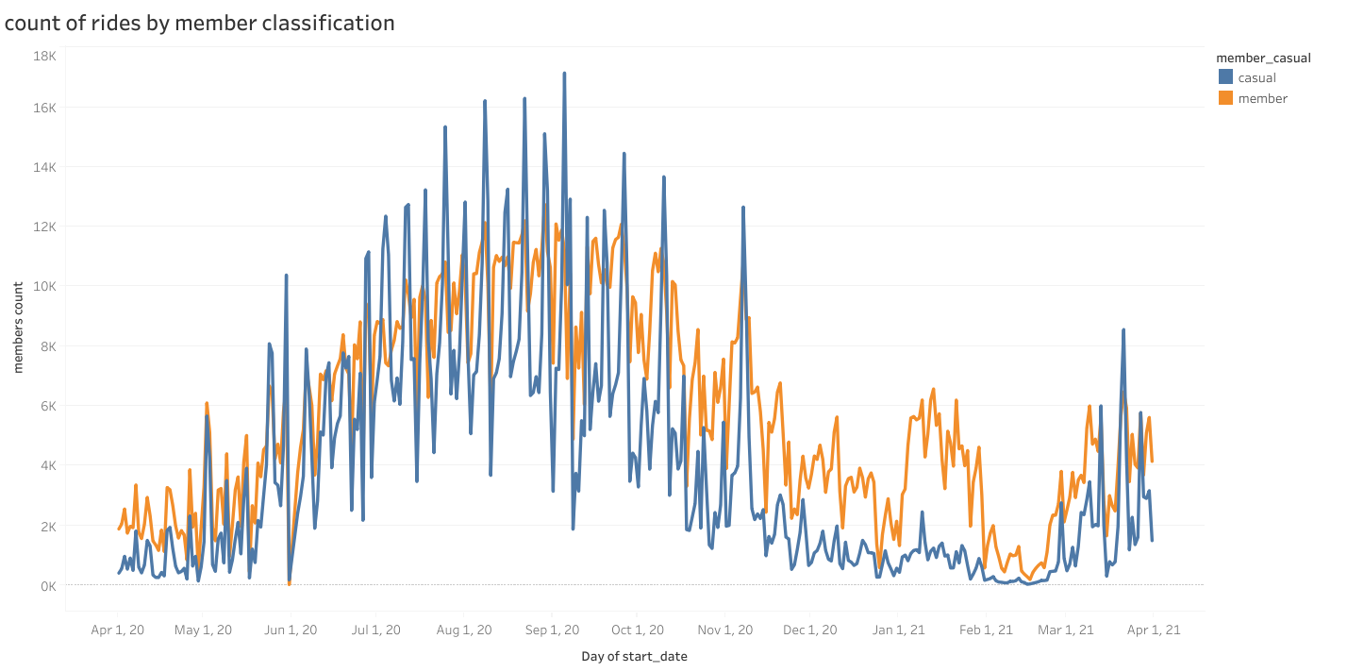
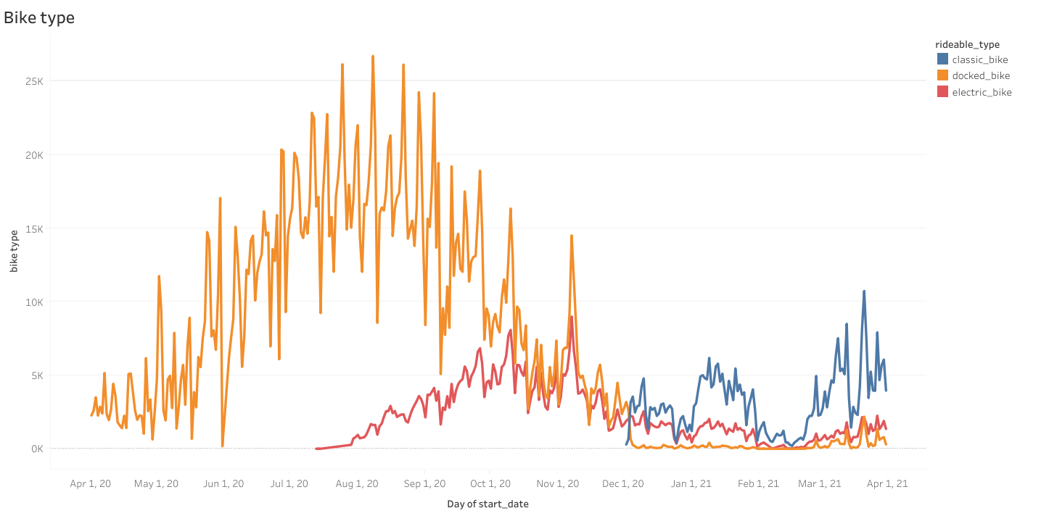
Here we find count of users and bike type
count of rides by member classification
Bike type according to usrs

Slide 10
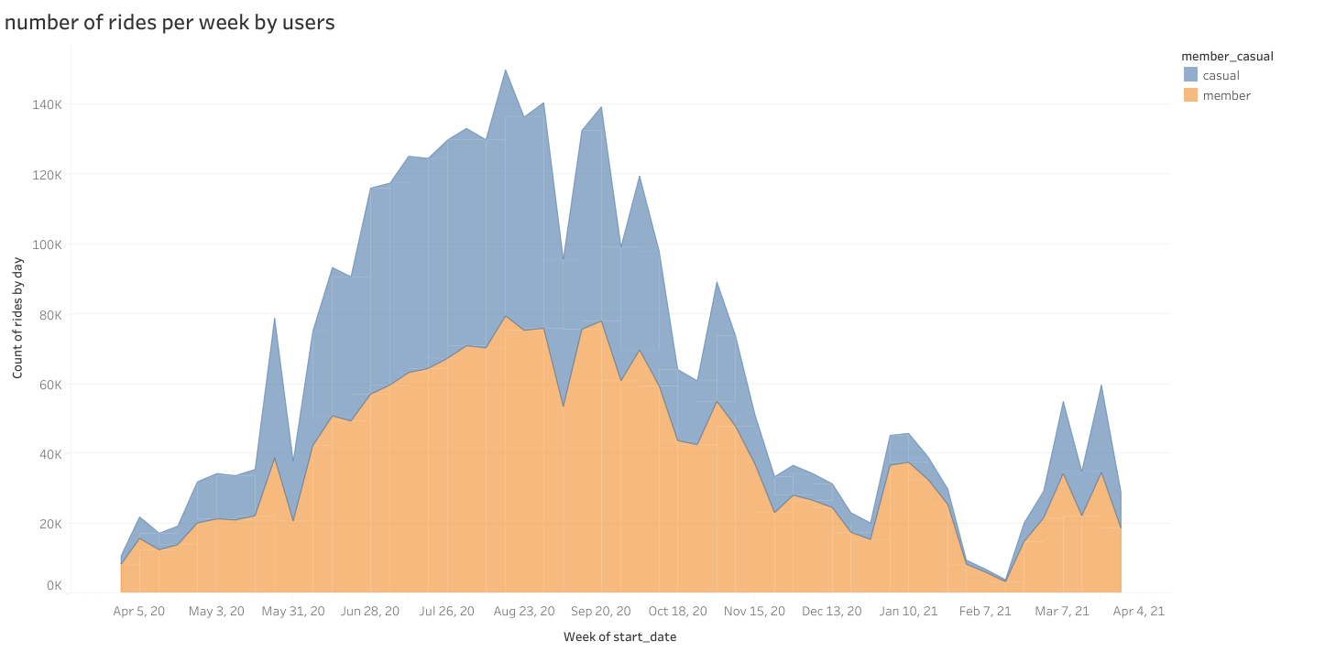
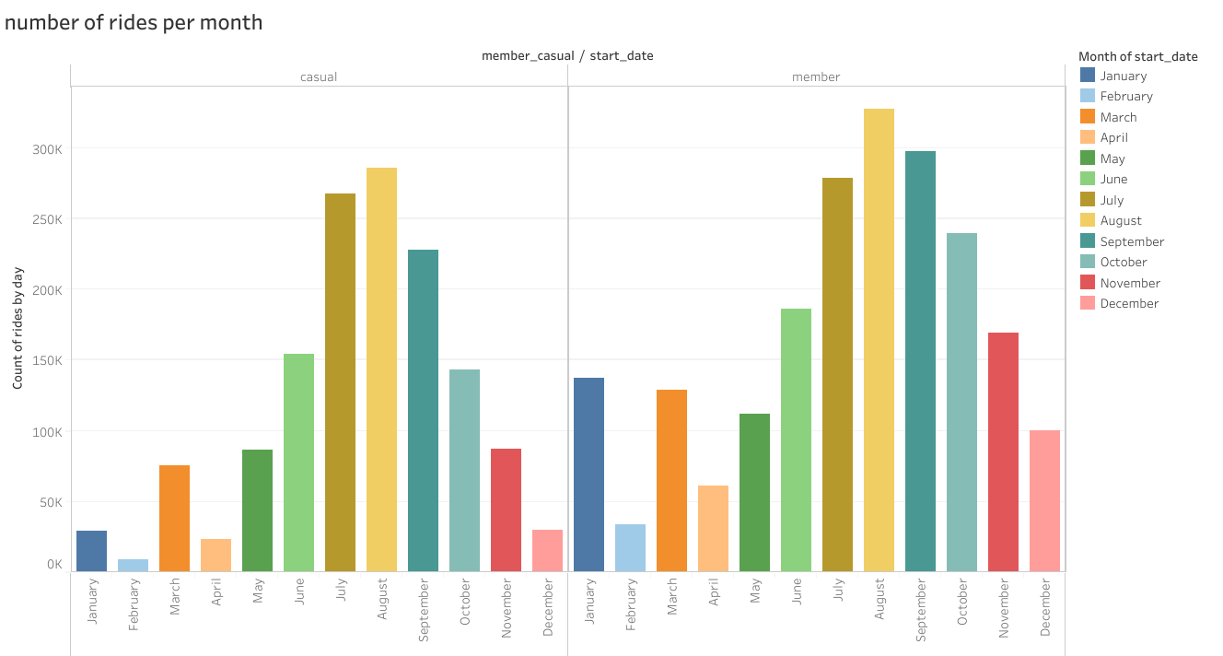
Number of rides per week and month
week
month

Slide 11
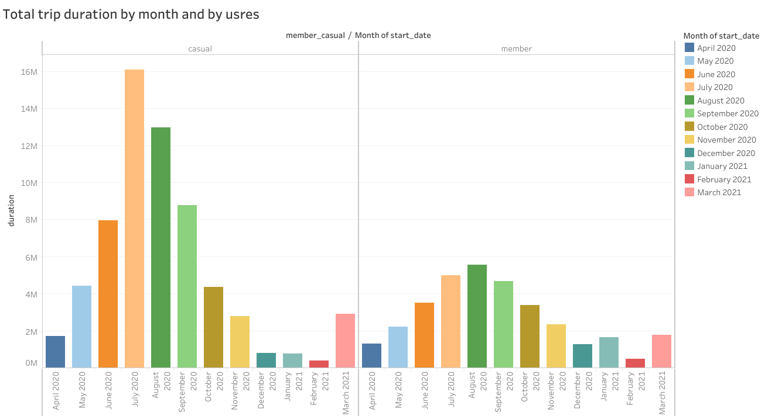
Total trip duration by month and by usres

Slide 12
Act phase
Final Conclusion and Recommendation
My answers to the firstquestions that will guide the future marketing program are as follows, based on my analysis and visualizations:
1- They both prefer to use docked bike than other bikes.
2- Our annual members use the Cyclistic bike sharing service frequently and consistently in terms of total ride and ride time.
3- On the other hand, casual riders do not use the bike frequently and consistently. Therefore, it is understandable that they do not prefer to switch to the annual membership plan. Despite this, casual riders like to cycle inconsistently compared to annual members, with long rides on weekends that we think are for fun and relaxation .

